Slide 1
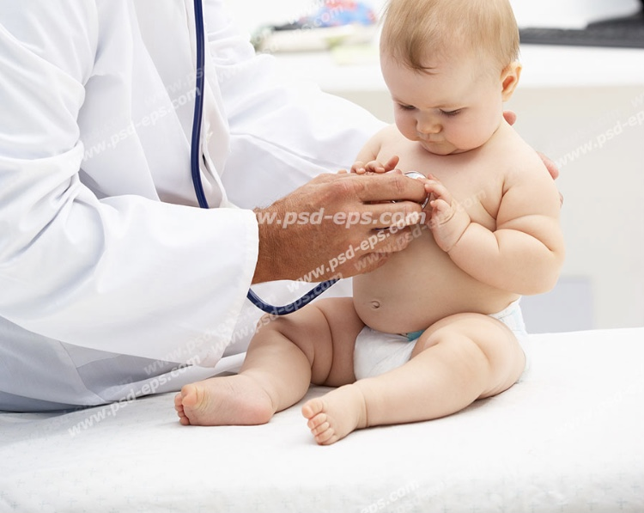

Pathophysiology of respiratory system
DR.Azam.gholami
Pediatric pulmonologist
Assistant professor of kerman university
of medical science
Instagram: dr.azam.gholami

Slide 2
Acute and chronic respiratory diseases are common in pediatrics.
Children with respiratory problems typically present with symptoms, although abnormal imaging may at times precede physical findings.
The underlying etiology of childhood respiratory diseases includes the following:

Slide 3
genetic abnormalities ( cystic fibrosis);
anatomical differences ( laryngomalacia);
incomplete maturation ( bronchopulmonary dysplasia);
iatrogenic effects ( ventilator-associated injury); immunological disorders ( severe combine immunodeficiency);
infectious diseases ( croup or pneumonia); environmental exposures ( pollutants);
and extrapulmonary consequences
( congenital heart disease).

Slide 4
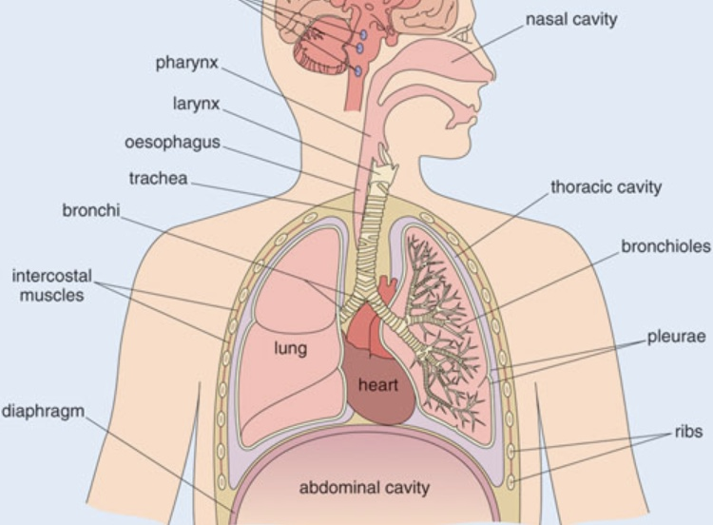
ANATOMY OF THE RESPIRATORY SYSTEM

Slide 5
Air enters the nose and passes over the large surface area of the nasal turbinates, which warm, humidify, and filter the inspired air.
Secretions draining from the paranasal sinuses are carried to the pharynx by the mucociliary action of the ciliated respiratory epithelium.
Enlarged lymphoid tissue can obstruct airflow through the nasopharynx (adenoids) or the posterior pharynx (tonsils).

Slide 6
The epiglottis protects the larynx during swallowing by deflecting material toward the esophagus.
The arytenoid cartilages, which assist in opening and closing the vocal folds, are less prominent in children than in adults.
The opening formed by the vocal folds (the glottis) is V-shaped, with the apex of the V being anterior

Slide 7
In children under 3 years of age, the cricoid ring is the narrowest portion of the airway.
In older children and adults it is the glottis.
C-shaped cartilage, extending approximately 320 degrees around the airway circumference, supports the trachea and mainstem bronchi.
The posterior wall of the trachea is membranous, allowing airway caliber to change during inspiration and expiration.

Slide 8
Airway formation and branching is complete at birth, although length and caliber continue to increase until final adult height is achieved.
The right lung has three lobes (upper, middle, lower) and comprises approximately 55% of the total lung volume.
The left lung has two lobes (upper, lower); the inferior division of the left upper lobe, the lingula, is analogous to the right middle lobe.
The lung parenchyma, where gas exchange occurs, is comprised of the respiratory bronchioles, alveolar ducts, and alveoli.
Oxygen (O2) and carbon dioxide (CO2) must traverse alveolar and capillary membranes and the interstitium to maintain adequate oxygenation and ventilation to meet the metabolic demands of the body.

Slide 9
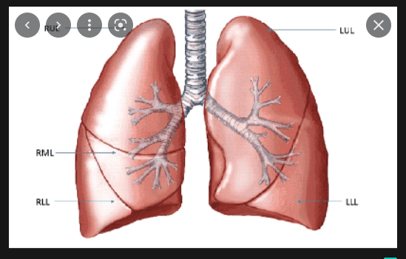

Slide 10
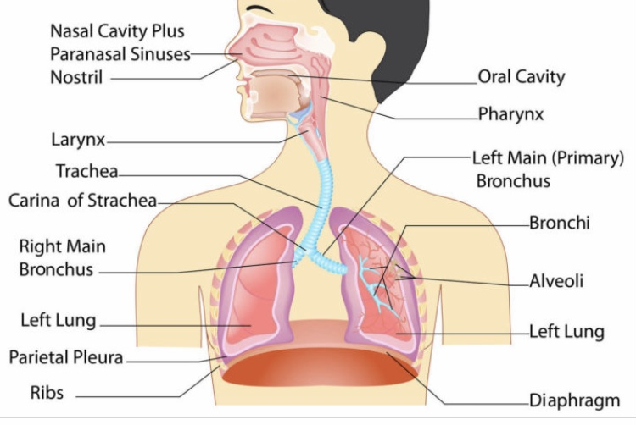
The pediatric lung has tremendous capacity for growth.
A full-term infant has approximately 25 million alveoli; an adult nearly 300 million alveoli.
The growth of new alveoli occurs during the first 2 years of life and is complete by 8 years of age.
After this time, lung volume increases primarily by increase in alveolar dimensions, with new alveoli rarely formed

Slide 11
PULMONARY PHYSIOLOGY
Pulmonary Mechanics
The major function of the lungs is to exchange O2 and CO2 between the atmosphere and the blood.
The anatomy of the airways, mechanics of the respiratory muscles and rib cage, nature of the alveolar-capillary interface, pulmonary circulation, tissue metabolism, and neuromuscular control of ventilation all influence gas exchange.
Air enters the lungs when intrathoracic pressure is less than atmospheric pressure.
Negative intrathoracic pressure is generated by contraction and lowering of the diaphragm during normal inspiration.
The accessory muscles of inspiration (external intercostal, scalene, and sternocleidomastoid muscles) are not used during quiet breathing but are recruited during exercise or in disease states to raise and enlarge the rib cage.

Slide 12
. Exhalation is normally passive, but with active exhalation the abdominal and internal intercostal muscles are recruited.
During normal breathing at rest, lung volumes are usually in the midrange of inflation .
Tidal volume (TV) is the amount of air inspired with each relaxed breath.
The volume of gas retained in the lung at the end of a relaxed exhalation is the functional residual capacity (FRC).
This gas volume maintains exchange of O2 between breaths.
Total lung capacity (TLC) is the volume of gas in the lungs at the end of maximal inhalation and
residual volume (RV) is the volume of gas left in the lungs at the end of a maximal exhalation.
Vital capacity (VC) is the maximal amount of air that can be forcibly expelled from the lungs and is the difference between TLC and RV

Slide 13
Airway resistance is influenced by the diameter and length of the conducting airways, the viscosity of gas, and the nature of the airflow.
During quiet breathing, airflow in the smaller airways is laminar (streamlined).
At higher flow rates, turbulent flow increases resistance.
Resistance is inversely proportional to the fourth power of the radius of the airway, so relatively small changes in airway diameter can result in large changes in airway resistance.
Excessive airway secretions, bronchospasm, mucosal edema, stenosis, foreign bodies, loss of airway wall integrity (bronchiectasis), and airway compression may all produce symptomatic increases in airway resistance.
Diseases that impact airway resistance, particularly lower airway resistance, fall into the category of obstructive airways disease.

Slide 14
Lung compliance (change in volume for a given change in pressure) is a measure of the ease with which the lung can be inflated.
Processes that decrease lung compliance (surfactant deficiency, pulmonary fibrosis, pulmonary edema) may lead to restrictive lung disease.
Restrictive lung disease can also result from respiratory muscle weakness, pleural disease (effusion, inflammation, or mass), thoracic stiffness (scoliosis), and abdominal distention.

Slide 15
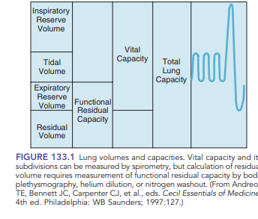

Slide 16
Respiratory Gas Exchange
Alveolar ventilation is defined as the exchange of CO2 between the alveoli and ambient air.
Normally, about 30% of each tidal breath fills the conducting airways (anatomical dead space).
Because the anatomical dead space is relatively constant, increasing the TV generally increases the efficacy of ventilation.
Conversely, if TV decreases, then the dead space/TV ratio increases and alveolar ventilation decreases.

Slide 17
Gas exchange depends on alveolar ventilation, pulmonary capillary blood flow, and the diffusion of gases across the alveolar-capillary membrane.
Exchange of CO2 is determined by alveolar ventilation, whereas the exchange of O2 is influenced primarily by the regional matching of ventilation (V) with pulmonary blood flow (Q) (V/Q matching).
V/Q matching is maintained, in part, by hypoxic pulmonary vasoconstriction (local constriction of the pulmonary vessels in areas that are underventilated).
There are five causes of hypoxemia .
Disorders resulting in V/Q mismatching (such as pneumonia and atelectasis) are the most common causes of hypoxemia in children.

Slide 18
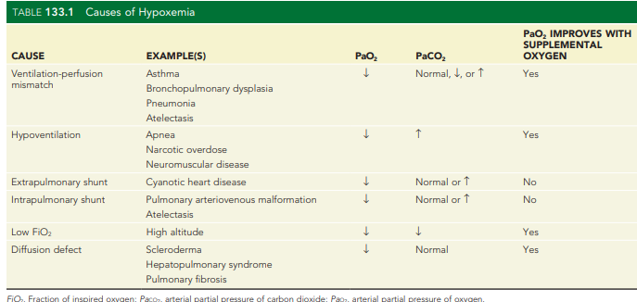

Slide 19
Cough is a critically important mechanism for protecting the lungs from infection. It may be voluntary or generated by reflex irritation of the nose, sinuses, pharynx, larynx, trachea, bronchi, or bronchioles.
Cough is a rapid, forceful expiration intended to clear the airways of debris and secretions.
Effective cough requires the ability to (1) inhale to near TLC, (2) close and open the glottis, and (3) contract abdominal muscles to forcibly exhale.
Loss of the ability to cough, as with neuromuscular weakness, results in poor secretion clearance and predisposes to atelectasis and pneumonia.
Persistent cough suggests chronic irritation at any of these sites due to infectious (e.g., chronic bronchitis), allergic (e.g., postnasal drip, asthma), or chemical (e.g., inhalation or aspiration) triggers

Slide 20
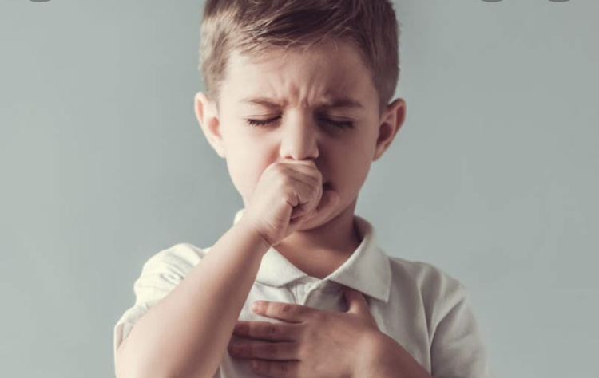
HISTORY
Common respiratory complaints in children include cough, labored or noisy breathing, chest pain, and exercise intolerance.
The complete respiratory history includes onset, duration, and frequency of symptoms.
It is important to obtain information concerning severity (hospitalizations, missed school days) and pattern (acute, chronic, or intermittent), including factors leading to worsening or improvement

Slide 21
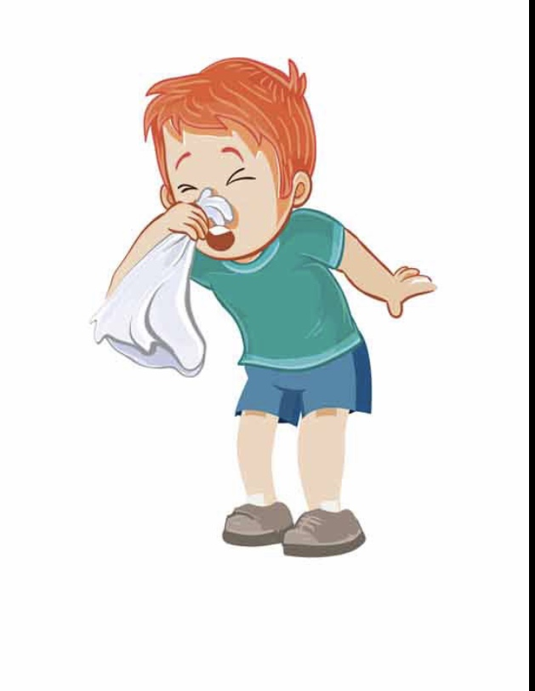
Exposure to others with respiratory illness and environmental factors (such as pet dander, tobacco smoke, or chemical fumes) should be reviewed.
For infants, a feeding history should be obtained, including questions of coughing or choking with eating or drinking.
Family history should include questions about asthma and atopy, immune deficiencies, and cystic fibrosis.

Slide 22
Cough
Morning cough may be due to the accumulation of excessive secretions during the night from sinusitis, allergic rhinitis, or bronchial infection.
Nighttime cough is a hallmark of asthma and can also be caused by gastroesophageal reflux disease or postnasal drip

Slide 23
Cough with exercise is highly suggestive of exercise-induced asthma/bronchospasm.
Habit cough can masquerade as organic disease but should disappear when children are distracted or during sleep.
Paroxysmal cough (especially associated with cyanosis) suggests pertussis, whereas a repetitive, staccato cough occurs in chlamydial infections in infants.
A harsh, brassy, seal-like cough suggests croup, tracheomalacia, or psychogenic (habit) cough.
Sudden onset of cough after a choking episode suggests foreign body aspiration

Slide 24
Stridor ,Wheezing ,Cyanosis
Clothing should be removed from the upper half of the child’s body so that the thorax may be inspected while maintaining modesty for adolescents.
It is optimal to observe the respiratory pattern, rate, and work of breathing while the child is quiet, noting the shape and symmetry of the chest wall and the anteroposterior (AP) diameter.
Any factor that impairs respiratory mechanics is likely to increase the respiratory rate

Slide 25
However, nonrespiratory causes of tachypnea include fever, pain, and anxiety.
Respiratory rates vary with age
It is important to observe the respiratory pattern and degree of effort (work of breathing).
Increased work of breathing can be described as inspiratory (intercostal, supraclavicular, or substernal retractions, nasal flaring) or expiratory (use of abdominal muscles to actively exhale)
Causes of increased work of breathing during inspiration include extrathoracic airway obstruction (laryngomalacia, croup, subglottic stenosis) and/or decreased pulmonary compliance (e.g., pneumonia, pulmonary edema)

Slide 26
Increased expiratory work of breathing usually indicates intrathoracic airway narrowing (e.g., asthma, tracheomalacia).
Grunting (forced expiration against a partially closed glottis) is often seen in small children with respiratory distress but may also be a manifestation of pain.
When attempting to determine the cause of a respiratory complaint, it is useful to auscultate over all potential sites of pathology,
including the nose and mouth, neck, large airways (central chest and back), and all lobes of both lungs (anterior and posterior, upper and lower, as well as lateral chest wall).

Slide 27
Stridor
Stridor is a harsh, monophonic sound caused by a partially obstructed large airway, more commonly heard on inspiration and localized to the neck
Wheezing
is produced by partial obstruction of the smaller lower airways, more commonly heard during exhalation and localized to the chest.
Wheezes can be monophonic and low-pitched (usually from large, central airways) or high-pitched and musical (from small peripheral airways.

Slide 28
Secretions in the intrathoracic airways may produce wheezing but more commonly result in irregular sounds called rhonchi
Fluid or secretions in small airways may produce sounds characteristic of crumpling cellophane (crackles or rales)

Slide 29
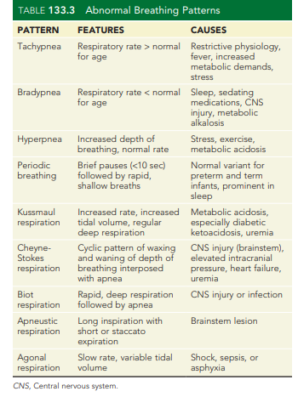

Slide 30
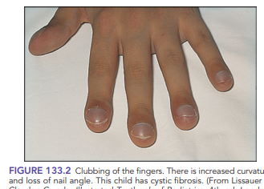
Digital clubbing
is seen in cystic fibrosis and in other, less common chronic pulmonary diseases (such as interstitial lung disease).
It is not associated with asthma, so its presence should heighten concern for other diagnoses.
Clubbing may also be present in nonpulmonary chronic diseases (cardiac, gastrointestinal, or hematological) or, rarely, as a familial trait.

Slide 31
DIAGNOSTIC MEASURES
Imaging Techniques
Chest radiographs are useful in assessing respiratory disease in children.
In addition to determining lung abnormalities, they provide information about the bony thorax (rib or vertebral abnormalities), the heart (cardiomegaly, pericardial effusion), and the great vessels (right aortic arch/vascular rings, rib notching).
Chest radiographs should be obtained in both the posteroanterior (PA) and lateral projections and, if possible, following a full inspiration

Slide 32
A barium esophagram
may be valuable in diagnosing disorders of swallowing (dysphagia) and esophageal motility, vascular rings (esophageal compression), tracheoesophageal fistulas, and, to a lesser extent, gastroesophageal reflux.
When evaluating for a tracheoesophageal fistula, contrast material must be instilled under pressure via a catheter with the distal tip situated in the esophagus

Slide 33
Computed tomography (CT) of the chest is the imaging tool of choice for evaluating masses, interstitial lung disease, and bronchiectasis, as well as delineating pleural from parenchymal lesions.
CT scans with intravenous contrast provide excellent information about the pulmonary vasculature and great vessels, are useful for characterizing congenital pulmonary malformations, and can detect pulmonary embolism.

Slide 34
Magnetic resonance imaging (MRI), useful in visualizing cardiac and great vessel anatomy and mediastinal lesions, is less useful for evaluation of pulmonary parenchymal lesions.
Ultrasonography can be used to delineate some intrathoracic masses and is the imaging procedure of choice for assessing size and character of parapneumonic effusion/empyema.
It is also useful for assessing diaphragmatic motion in small children.

Slide 35
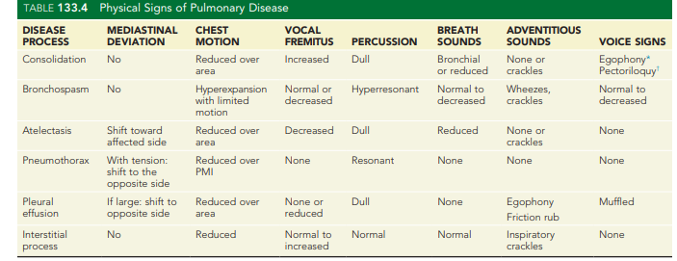

Slide 36
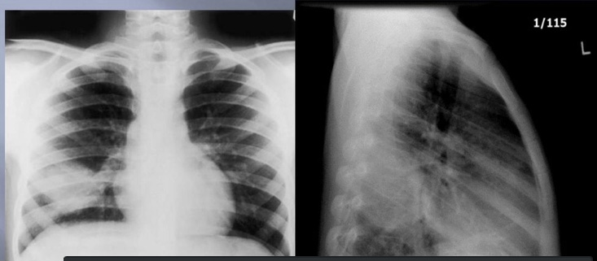
consolidation

Slide 37
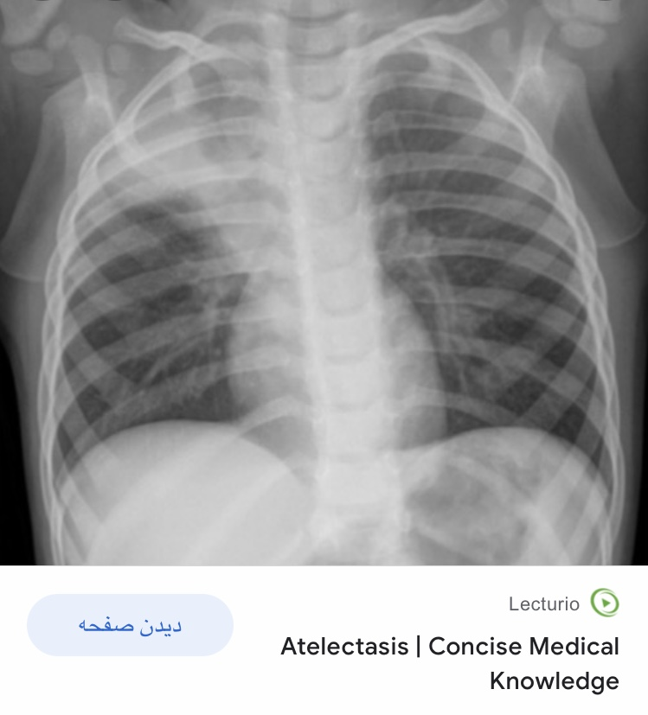
atelectasis

Slide 38
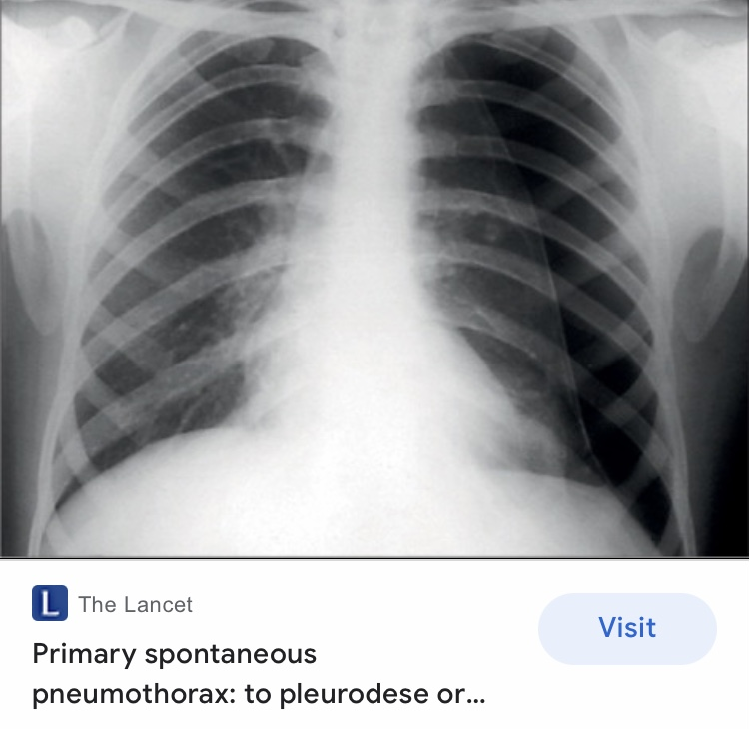
Pneumothorax

Slide 39
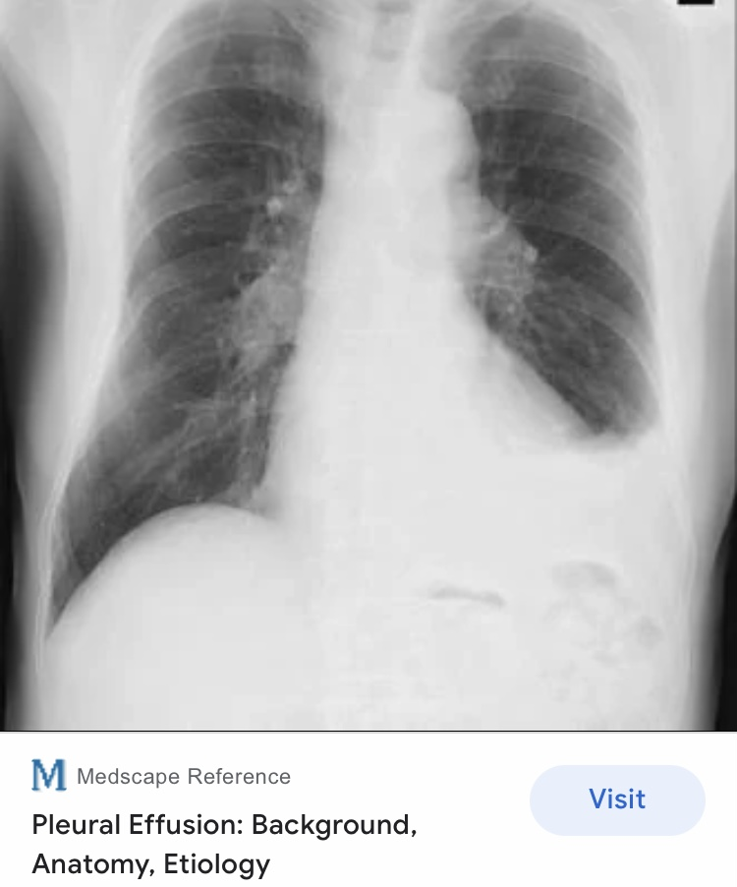
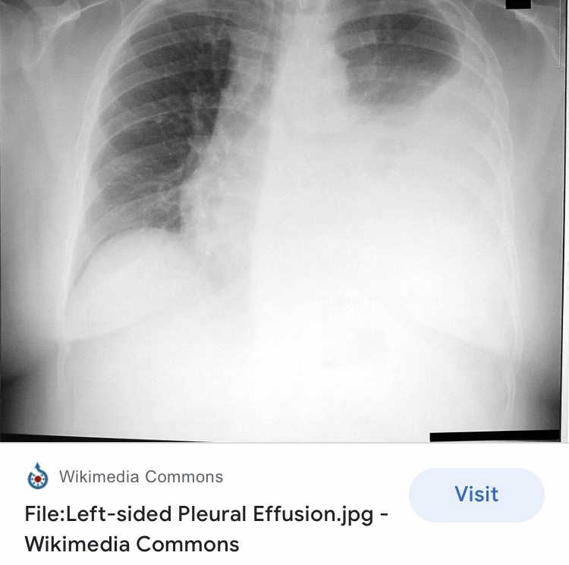

Slide 40
Measures of Respiratory Gas Exchange
A properly performed arterial blood gas analysis provides information about the effectiveness of both oxygenation and ventilation.
As arterial samples are difficult to obtain, capillary and venous blood samples are more commonly used.
Capillary or venous samples should not be used to assess oxygenation.
The partial pressure of carbon dioxide (PCO2) from a capillary sample is similar to that from arterial blood.
The PCO2 in venous samples is approximately 6 mm Hg higher than arterial PCO2. There are both respiratory and metabolic causes of acidosis

Slide 41
Pulse oximetry
measures the O2 saturation of hemoglobin by measuring the blood absorption of two or more wavelengths of light.
It is noninvasive, easy to use, and reliable.
Pulse oximetry may not accurately reflect true O2 saturation when abnormal hemoglobin is present (carboxyhemoglobin, methemoglobin), when perfusion is poor, or if no light passes through to the photodetector (nail polish).

Slide 42
Pulmonary Function Testing
Measurement of lung volumes and airflow rates using spirometry are important in assessing pulmonary disease.
Most children above 6 years of age can perform spirometry.
The peak expiratory flow rate (PEFR) can be obtained with a simple hand-held device and may be useful for home monitoring of older children with asthma;
however, it is highly dependent on patient effort, and values must be interpreted with caution.
Measurement of TLC, FRC, and RV require body plethysmography

Slide 43
Endoscopic Evaluation of the Airways
Endoscopic evaluation of the upper airways (nasopharyngoscopy) is performed with a flexible fiberoptic nasopharyngoscope to assess adenoid size, patency of the nasal passages, and abnormalities of the glottis.
It is especially useful in evaluating stridor and assessing vocal cord motion/function and does not require sedation.

Slide 44
Flexible bronchoscopy is useful in identifying dynamic or static airway abnormalities (stenosis, malacia, endobronchial lesions, excessive secretions) and to obtain airway samples for culture (bronchoalveolar lavage).
Rigid bronchoscopy is the method of choice for removing foreign bodies from the airways and performing other interventions, such as airway dilation.

Slide 45
Oxygen Administration
Any child in respiratory distress should be treated with supplemental oxygen at concentration sufficient to maintain acceptable O2 saturation levels.
Normal O2 saturation is greater than 95%;

Slide 46
Aerosol Therapy
Therapeutic agents such as bronchodilators, corticosteroids, and antibiotics can be delivered to the lower respiratory tract by dry powder inhaler (DPI), metered-dose inhaler (MDI), or nebulizer.
Nebulizers should be used with a face mask (infants) or mouthpiece (children and teens) to minimize loss of drug to ambient air

Slide 47
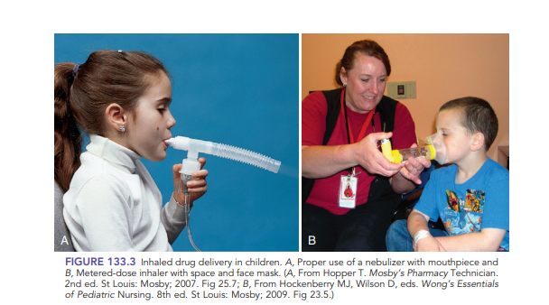
. Plastic holding chambers (spacers) are available for all ages and should always be used with MDIs.
DPIs require a single rapid, deep inhalation for optimal drug delivery, which is difficult for children under 6 years of age.
MDIs and nebulizers are equally effective in delivering medications only if the technique is correct

Slide 48
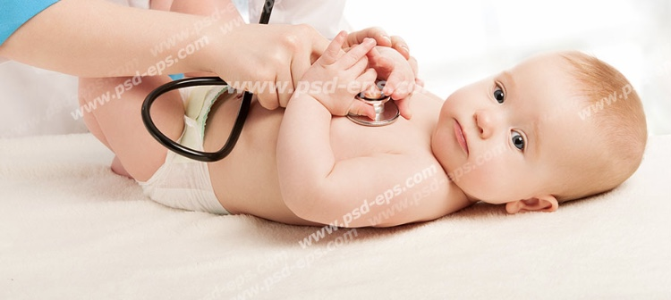
Thank you for attention
Instagram:dr.azam.gholami

